Slide 1
Cyclistic Bike Share Case Study
Presented by: Aryan Juyal
Last Updated: July 8th, 2023

Slide 2
Agenda
Introduction
Project Overview
Exploratory Data Analysis
Finding and Results
Recommendations
Conclusion

Slide 3
Introduction
Cyclistic is a fictitious bike-sharing program that operates with an extensive fleet of 5,824 bicycles and 692 docking points. While the majority of users enjoy riding for leisure, approximately 30% rely on Cyclistic bikes for their daily work commute. The program offers three pricing options: single-ride passes, full-day passes, and annual memberships.
Casual riders are customers who purchase single rides or full-day passes, while member riders are those who opt for annual memberships. As a Junior Data Analyst in the marketing analytics team, my role at Cyclistic involves analyzing data to support the company's marketing strategies.

Slide 4
Introduction
Cyclistic's financial analysts have determined that annual members generate significantly higher profits compared to casual riders. Therefore, the marketing director believes that increasing the number of yearly subscriptions is vital for the company's future success.
The marketing strategy aims to convert casual riders into loyal annual members by leveraging data insights and tailored marketing campaigns.

Slide 5
Project Overview
For this project, I had the opportunity to work on a fascinating case study based on the Cyclistic Bike Share program. As a junior data analyst in the marketing analytics team, my objective was to analyze the bike trip data and uncover key insights that could drive the company's marketing strategy.
A six-step data analysis process was used in this case study: Ask, Prepare, Process, Analyze, Share, and Act.
The business task is to investigate how casual and member riders use Cyclistic differently, with the goal of developing a new marketing approach to convert casual riders into annual members.

Slide 6
Project Overview
For this project, the data was sourced from Divvy, a Chicago-based bike-share firm, through their public data link, Divvy Trip Data. The data is organized by month and year, saved as a zip file, and consists of CSV files with reliable, original, comprehensive, and current information.
The data is accessible to the public, adheres to data-privacy rules, and is anonymized to ensure privacy. The chosen data files for the project cover the 12 months from November 2021 to October 2022 and were appropriately downloaded, saved as CSV files, and labeled for easy recognition.

Slide 7
Exploratory Data Analysis
Step 1: Ask Questions and define the problem
In this initial stage, the project aims to understand the differences between annual members and casual users of Cyclistic bikes, explore the motivations behind casual riders purchasing annual memberships, and identify opportunities for utilizing digital media to attract more casual riders. The ultimate goal is to develop a new marketing strategy that converts casual riders into loyal annual members. The key stakeholders involved include the marketing director responsible for campaign development, the Cyclistic executive team for approval, and the marketing analytics team for data analysis and reporting.

Slide 8
Exploratory Data Analysis
Step 2: Prepare the data by collecting and storing information
Data Location: The data for this research comes from Divvy, a Chicago-based bike-share firm, and is accessed through Divvy's public data link, Divvy Trip Data.
Data Organization: The historical trip data is organized by month and year, saved as zip files, and consists of CSV files with rows and columns.
Credibility and Accessibility: The data is derived from Divvy's public historical trip data, making it reliable, original, comprehensive, current, and cited. It adheres to data-privacy rules, is anonymized, and does not contain personally identifiable information. The data is accessible to the public on a monthly basis.

Slide 9
Exploratory Data Analysis
Download and Storage: Data files for the 12 months from November 2021 to October 2022 were selected, downloaded, saved as CSV files, and consistently labeled.
Data Processing: Excel was initially used to sort, filter, and check the data for duplicates and blank/NA records. However, due to the large dataset, the project transitioned to using R and RStudio for further analysis.
R Packages and Data Frames: R packages such as tidyverse, lubridate, and ggplot were installed and loaded for data import, wrangling, and visualization. The 12 CSV files were uploaded and stored as separate data frames.
Data Frame Consistency: The column consistency of all 12 data frames was checked.

Slide 10
Exploratory Data Analysis
Combining Data Frames: The 12 data frames were combined into a single data frame named "bike_rides" using the rbind function.
Data Frame Inspection: The data frame was inspected using various functions to ensure data integrity and consistency with the initial observations made in Excel.
Exploring the Data: Functions like select, nrow, ncol, length, head, tail, glimpse, str, summary, names, rownames, and skim_without_charts were used to gain a better understanding of the data structure and variables.

Slide 11
Exploratory Data Analysis
Missing Data and Limitations: The is.na function was used to identify missing data, and limitations and flaws in the data were identified, such as user privacy restrictions and incomplete mapping of bike trips to customers.
Addressing the Business Task: Despite the limitations, the historical travel data from Divvy is appropriate for answering business questions and gaining insights into the usage patterns of casual and member users, such as bike type usage and trip length by customer type and time variables.

Slide 12
Exploratory Data Analysis
Step 3: Process the data by cleaning and checking the information
Selecting Tools: R and RStudio are chosen for data manipulation, cleaning, aggregation, analysis, and visualization due to the large dataset of 5.7 million rows.
Data Transformation: Columns are renamed, the datetime format is standardized, and a new column called "ride_length_min" is added to calculate the length of each trip.
Handling Missing Values: Missing start and end station IDs and names are addressed by imputing rounded latitude and longitude coordinates. The remaining missing data is deemed insignificant and does not affect the dataset's integrity.
Data Cleaning: Insignificant data, such as 1-minute rides with missing end-lat and end-lng, is removed for accuracy and efficiency.

Slide 13
Exploratory Data Analysis
Explore "Testing" Data: Identified and investigated data related to "testing" trips in the dataset, which should be removed as they are not relevant to the analysis.
Data Removal: Removed rides less than 60 seconds and greater than 24 hours in length, rides with negative ride length, rides with missing end coordinates, and rides related to test/repair stations.
Data Frame Inspection: Examined the new data frame, bike_rides_v2, which contained 5,621,147 rows after cleaning, indicating the removal of 134,547 rows.
Data Verification: Verified that the data is now clean, correct, consistent, complete, and relevant through checks for duplicates, missing values, outliers, accuracy, completeness, consistency, relevance, data formats, and overall data quality.

Slide 14
Exploratory Data Analysis
Step 4: Analyzing and Visualizing the Data
Summary of Data Analysis: We proceed with analyzing the data to examine relationships and differences between annual members and casual riders.
User Type Breakdown: The data shows that 59% of riders are annual members, while 41% are casual riders. Both user types use classic and electric bikes, but only casual riders use docked bikes.
Ride Length Analysis: The average ride length is 16.63 minutes, with a minimum of 1 minute and a maximum of just under 24 hours. Most rides (97%) are 60 minutes or less, and 79% are 20 minutes or less. There is a higher proportion of annual members in rides under 12 minutes and 20 minutes.

Slide 15
Exploratory Data Analysis
Time Analysis: Casual riders tend to have longer rides, peaking between 10 AM and 2 PM. Member riders' ride lengths remain more consistent throughout the day. Both rider types have longer rides on weekends.- User Type Breakdown: The data shows that 59% of riders are annual members, while 41% are casual riders. Both user types use classic and electric bikes, but only casual riders use docked bikes.
Recap of Riders and Ride Length Analysis: The dataset consists of 5,621,147 rides, with 41% being casual riders and 59% being member riders. Both rider types use classic and electric bikes, but member riders take more rides while casual riders have longer average ride lengths.
Analysis of Total Rides by Time: Member riders peak in the early morning and late afternoon, while casual riders peak in the late afternoon. Early morning rides are mostly taken by member riders.

Slide 16
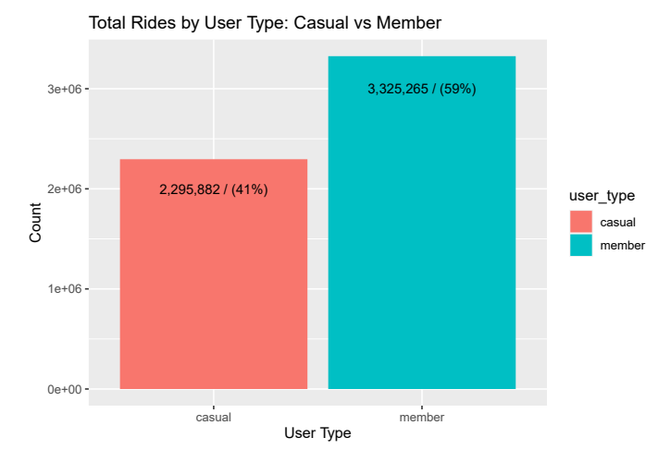
Exploratory Data Analysis
3,325,265 (or 59%) of riders are member riders, while 2,295,882 (or 41%) are casual riders

Slide 17
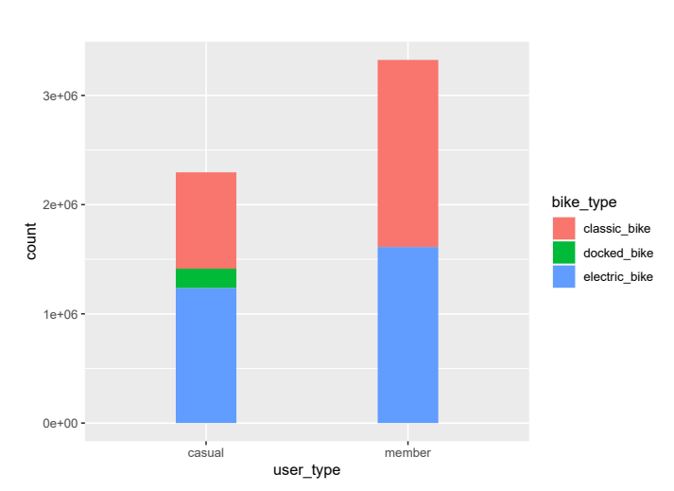
Exploratory Data Analysis
Member and casual riders use both the classic and electric bikes, while only casual users use docked bikes.

Slide 18
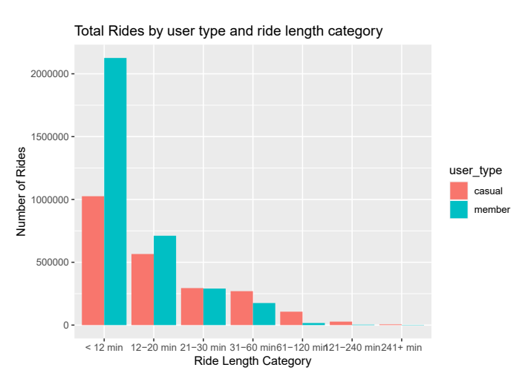
Exploratory Data Analysis
We can clearly see how the majority of rides fall into the first two categories

Slide 19
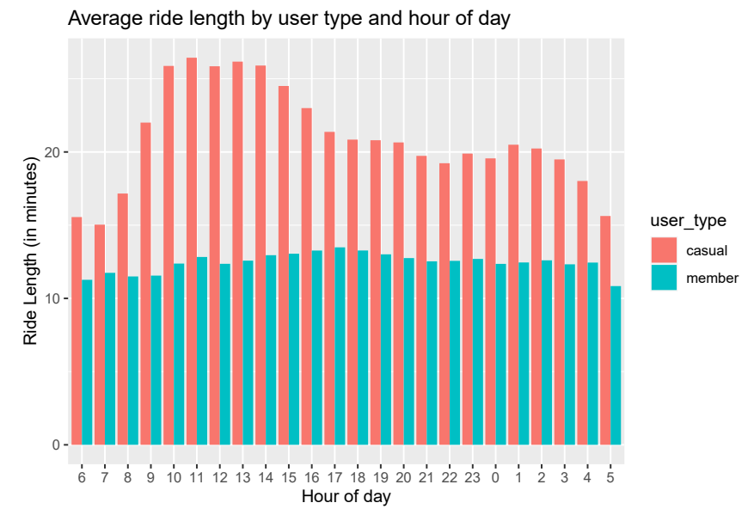
Exploratory Data Analysis
Casual riders average longer rides than member riders, peaking between 10 AM – 2 PM

Slide 20
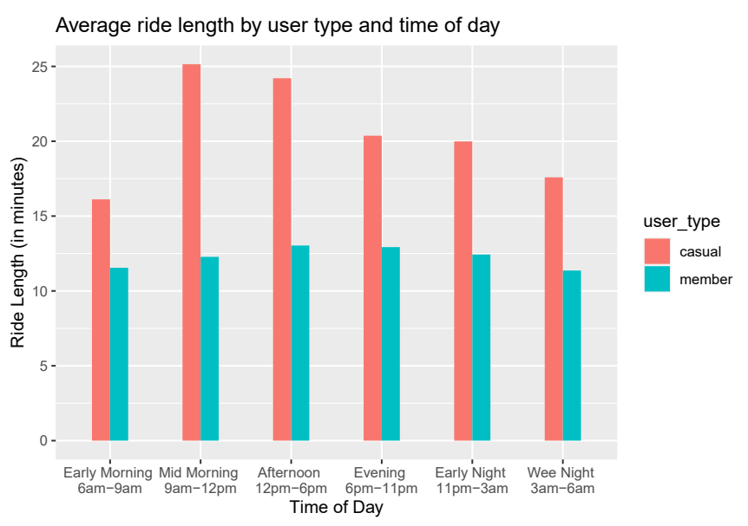
Exploratory Data Analysis
Ride length for casual riders peaks mid-morning through the afternoon. Ride length for member riders remains more steady throughout the day

Slide 21
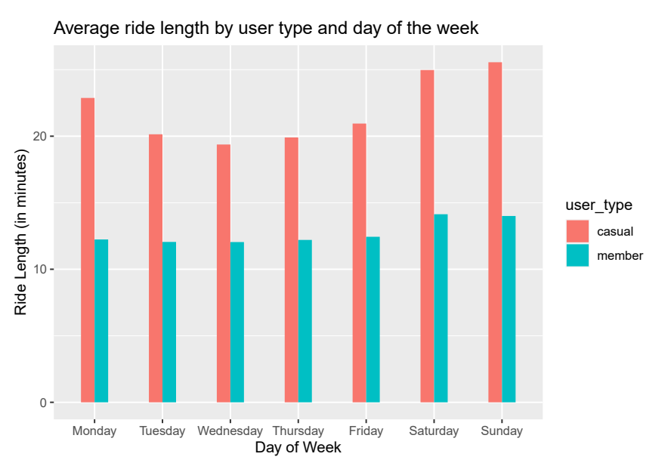
Exploratory Data Analysis
Both riders take longer rides on weekends

Slide 22
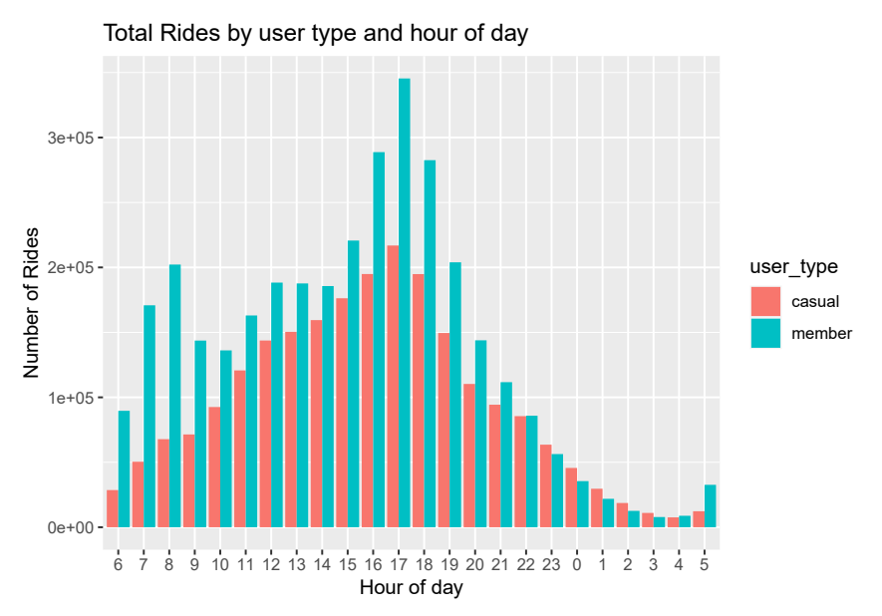
Exploratory Data Analysis
Member riders show strong use of rides starting at 6 am and peaking at 8 am and then again peaking further from 4 pm to 6 pm.
Casual rides also peak from 4 pm to 6 pm.
Member riders show strong use of rides starting at 6 am and peaking at 8 am and then again peaking further from 4 pm to 6 pm.
Casual rides also peak from 4 pm to 6 pm.

Slide 23
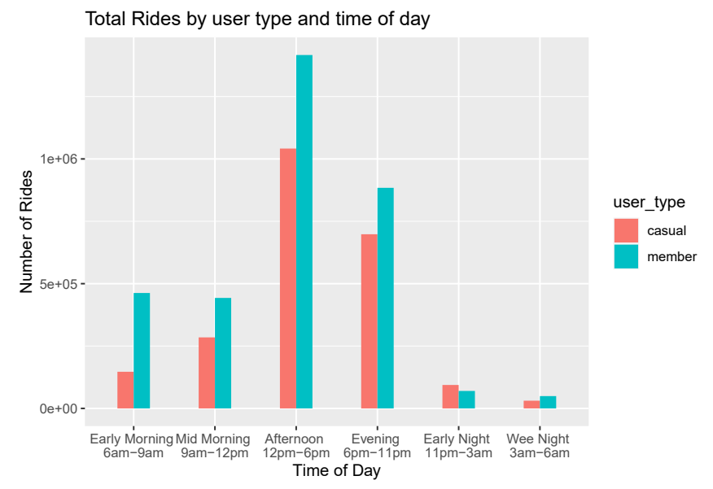
Exploratory Data Analysis
79% of early morning rides are taken by member riders.
Rides peak in the afternoon and evening for both riders.

Slide 24
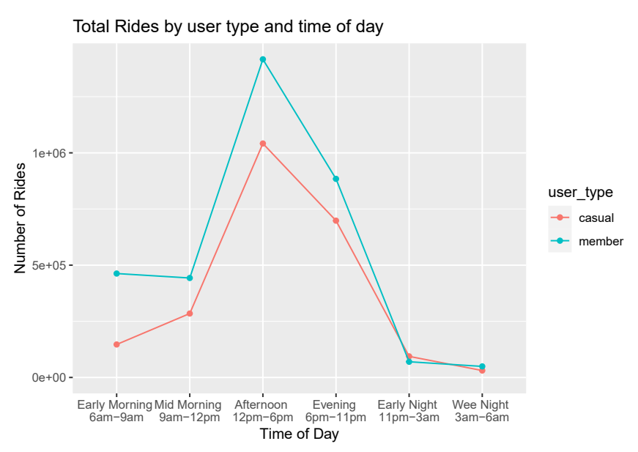
Exploratory Data Analysis
79% of early morning rides are taken by member riders.
Rides peak in the afternoon and evening for both riders.

Slide 25
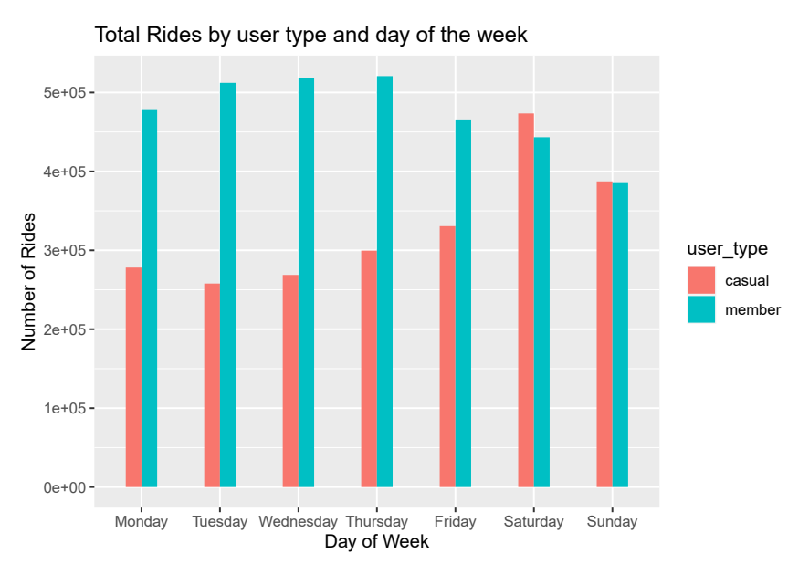
Exploratory Data Analysis
Member riders take the most rides between Monday through Thursday and decline a little over the weekend.
Casual riders take most rides on the weekend.

Slide 26
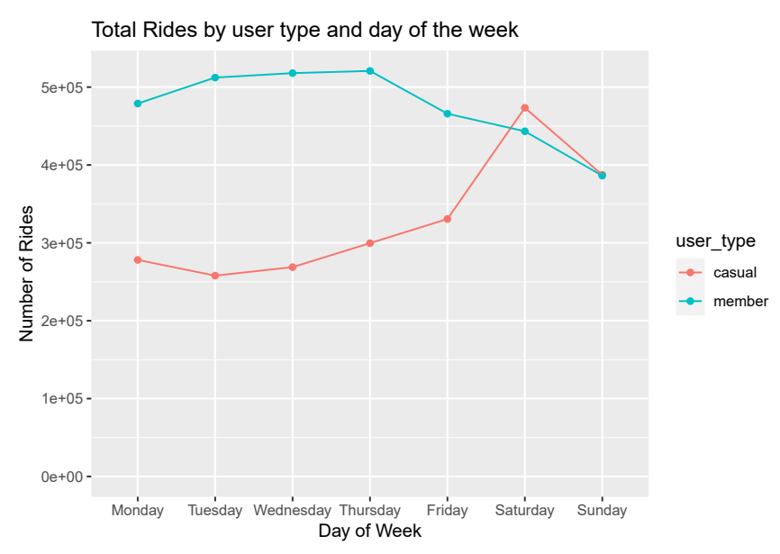
Exploratory Data Analysis
Member riders take the most rides between Monday through Thursday and decline a little over the weekend.
Casual riders take most rides on the weekend.

Slide 27
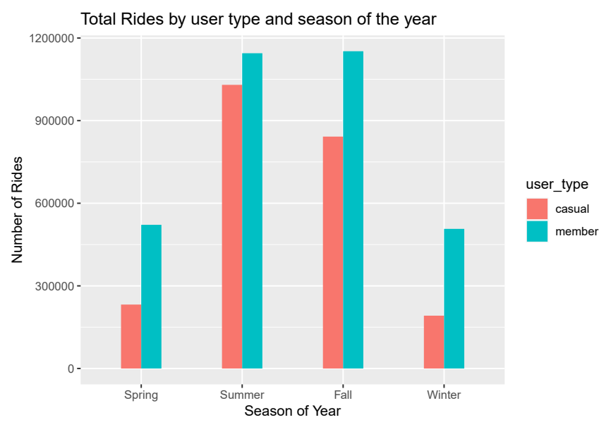
Exploratory Data Analysis
In each season we see more member rides.
Both riders peak in summer and decline in winter.

Slide 28
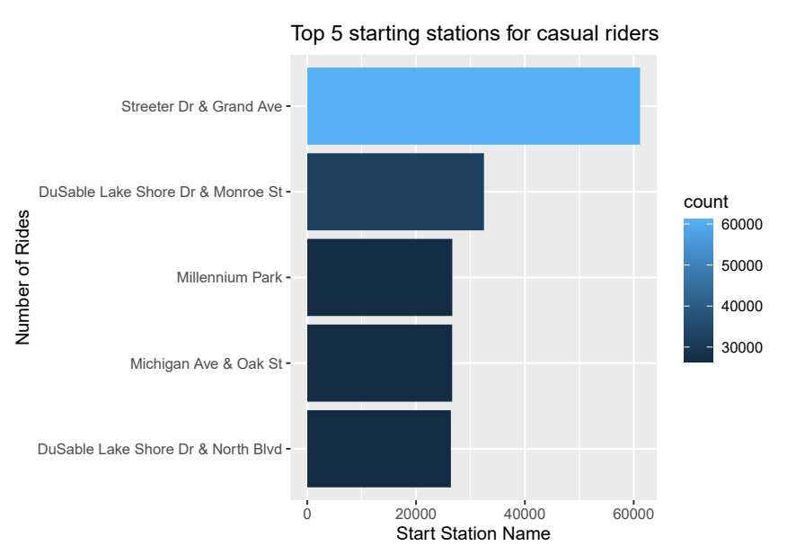
Exploratory Data Analysis
The top 5 starting and ending stations are the same for casual riders.
The top starting and ending station for casual riders is Streeter Dr & Grand Ave - situated near a park and shoreline sightseeing vacationers are likely visiting this area.

Slide 29
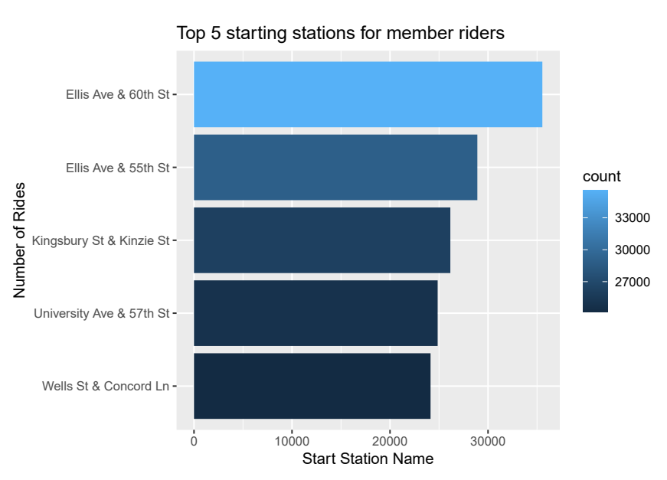
Exploratory Data Analysis
The top 5 starting and ending stations are the same for member riders except for one station.
The top starting and ending station for member riders is Ellis Ave & 60th St which is situated within the University of Chicago - this suggests that students, faculty, and staff are likely using this system.

Slide 30
Findings and Results
97% of all rides are 60 minutes or less, indicating the majority of rides are relatively short in duration.
79% of all rides are 20 minutes or less, further emphasizing the prevalence of shorter rides.
56% of all rides are less than 12 minutes, highlighting a significant portion of rides being brief in nature.
Member riders account for 67% of rides under 12 minutes, indicating a higher proportion compared to casual riders.
64% of rides lasting up to 20 minutes are taken by member riders, showcasing their dominance in this category.

Slide 31
Findings and Results
Member riders take more rides overall, prefer shorter rides, and their usage peaks on weekdays.
The top starting station for member riders is Ellis Ave & 60th St, suggesting its popularity among University of Chicago students, faculty, and staff.
Casual riders, on the other hand, tend to have longer average rides, ride more on weekends, and experience a peak in the summer.
The top starting station for casual riders is Streeter Dr & Grand Ave, indicating its appeal to vacationers near the park and shoreline sightseeing area.
While member rides dominate in all seasons, both member and casual riders see a peak in summer and a decline in winter.

Slide 32
Findings and Results
Additional Data Analysis to Consider:
The public dataset used in this study has privacy limitations, but additional analysis could provide valuable insights.
Analyzing the riding patterns of local casual riders, distinguishing between single riders and day pass riders, and understanding their riding style are important considerations.

Slide 33
Findings and Results
Examining the number and length of journeys for both local casual riders and member riders, as well as exploring the surrounding scenery, population density, nearby employers, educational and medical facilities, and infrastructure, can inform the development of a targeted marketing plan.
Gathering socioeconomic and cultural demographics will provide a further understanding of how these factors influence the riding behaviors of both groups.

Slide 34
Recommendations
Marketing should be an ongoing process, starting with a plan targeting ride length categories < 12 minutes and <= 20 minutes.
Focus on promoting the convenience, affordability, accessibility, and common uses of bike rides within this duration.
Market to individuals whose daily travel needs align well with the bike system, partnering with schools and companies and utilizing social media to showcase member riders and encourage referrals. Additionally, consider offering incentives for recruiting friends to bike to work or school.

Slide 35
Conclusion
Thank you for taking the time to look at my capstone project! Using real-world data and a business problem, this project guided me through the data analysis process from beginning to end. It’s incredibly pleasant to accomplish this in R and RStudio. I’m ecstatic and eager to advance in the field of data analysis.

